Slide 1
Unified Modeling Language (UML)
Phil Pfeiffer
March 2011
Sources:
Barrett course notes, CSCI 5300, spring 2010
Ambler, The Elements of UML Style
Page-Jones, Fundamentals of Object-Oriented Design in UML
various websites

Slide 2
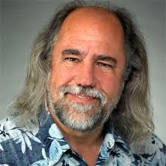


UML: History
1994: merger of 3 methods
▪ Grady Booch: Booch method
▪ Ivar Jacobson: OOSE, Objectory
▪ James Rumbaugh: OMT
Added extensions (incl. some from other methods)
Supports multiple system views
Standardized by Object Management Group
▪ Current: v2.2

Slide 3
UML: Diagram Types
Static (structural)
class, object, package, component,
composite structure, deployment
Behavioral
use case, statechart, activity
Interaction
sequence, communication (was collaboration), timing

Slide 4
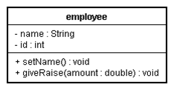
UML: Class Modeling
Ambler: always show at least name, attr, operator compartments
Name
▪ can include a path name
▪ abstract class names italicized
Attributes: with type, initial value, and visibility
▪ private: - or lock
▪ protected: # or key
▪ public: + or no-lock
Operators/ functions/ methods: with signatures, properties
▪ in, out, inout
▪ isQuery
▪ sequential
▪ guarded
▪ concurrent

Slide 5
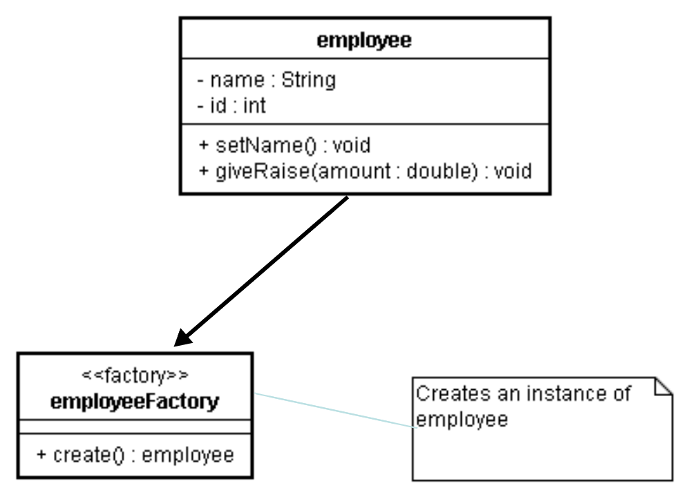
Class Diagrams: Responsibilities
Stereotypes
▪ metatypes
▪ <<name>> notation
▪ examples
▪ constructor
▪ query
Note object

Slide 6
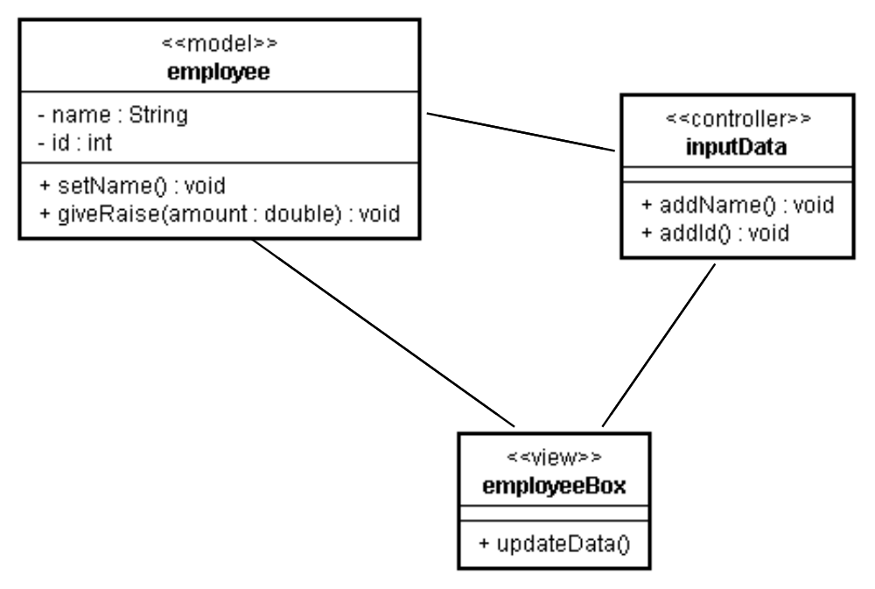
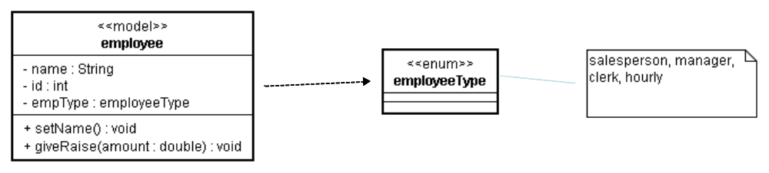
Sample Class Diagrams

Slide 7
UML and Class Relationships
▪ UML supports the modeling of these relationship types:
▪ Inheritance (is-a) using triangle
▪ Associations using , →
▪ Composition (has-a) using ◆
▪ Aggregation (data structure) using ◇
▪ Association class using - - →
▪ Dependency using - - -
▪ Instantiation (templates) using "superbox"
Less rich than Entity-Relationship
▪ E-R supports arbitrary relationships

Slide 8
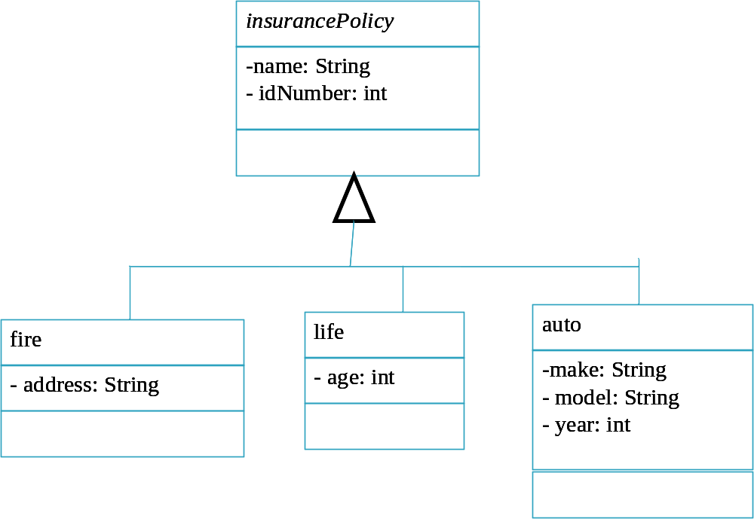
Inheritance

Slide 9
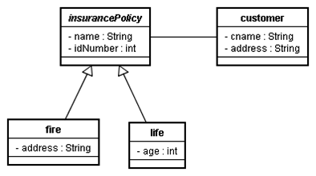
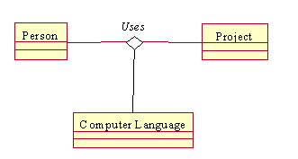
Associations (Binary, Ternary)

Slide 10
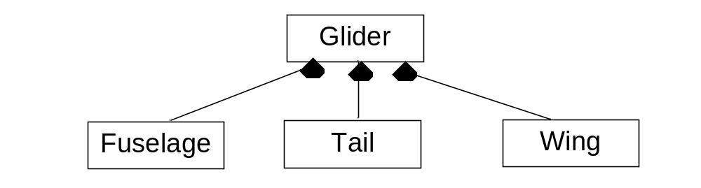
Composition
Think of diamond as an anchor
Three rules of composition
▪ the whole can't exist without the parts
▪ each part may only be in one composite at any one time
▪ composition generally heteromeric (i.e., mixed types)

Slide 11

Aggregation
Aggregate may exist without constituent objects (even though this may seem weird)
At any time, objects may be constituents of two or more aggregates
Aggregation tends to be homeomeric - i.e., of uniform type

Slide 12
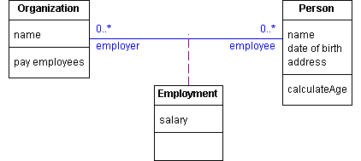
Association Class
Characterizes nature of an association

Slide 13
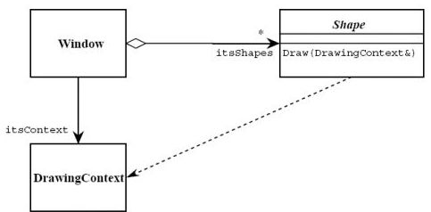
Dependency
Dependency: change in specification for one class affects the class that uses it, but not necessarily the opposite.
Here, shape's "draw self" routine depends on its context

Slide 14
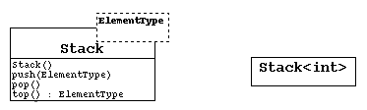
Template
Template
▪ family of classes, parameterized by type
▪ family relationship typically structural
C++ templates, Java generics would be modeled this way

Slide 15
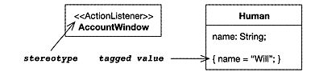
Tagged Values
▪ used to add new properties
▪ not attributes; applies to the element, not its instances - like class (static) data
▪ diagram: {tagname=value}
▪ pre-defined tags: documentation, location, persistence, semantics

Slide 16
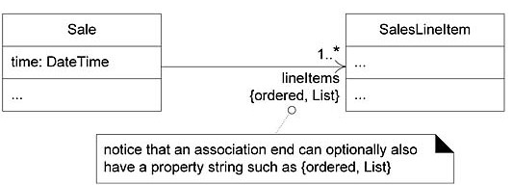
Constraints
add new semantics or change existing rules
specifies a condition that must be true for the model to be well-formed
pre-defined constraints include: implicit, new, or, transient
diagram: {text}, placed near the element

Slide 17
Advice for Class Diagrams (Ambler)
Use common terminology for class names
Prefer singular nouns for class names
Name class operations with a strong verb
Name class attributes with a domain-based name
Don't model scaffolding code (constructors, destructors, getters, setters)
Label uncommon compartments
End incomplete lists with ellipses
List operations/ attributes in order of decreasing visibility
Model relationships horizontally
Model collaboration only when classes have a relationship
Model non-persistent relationshps as dependencies
Always indicate multiplicity
Avoid "*" as a multiplicity -
use 0.."*", 1.."*" , etc. as appropriate
Don't model implied (i.e., transitive) relationships

Slide 18
Advice for Class Diagrams (Ambler)
Make associations bi-directional only when collaboration occurs in both directions: e.g.,
▪ A person knows his address, but
▪ an address doesn't know who's living at it
Apply the "IS KIND OF A" rule for superclass-subclass relationshpis
Place subclasses below superclasses
Apply the "IS PART OF" rule for aggregation
Be interested in the whole as well as the part - i.e.,
▪ only model watch hands explicitly if there's a value to doing so that's independent
of the watch
Place the whole to the left of the part
Apply composition when the parts share the persistence lifecycle of the whole
When deciding whether to use composition or aggregation over association … "when in doubt, leave it out".

Slide 19
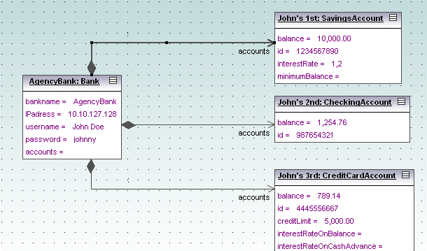
UML Object Diagram
Depicts snapshot of system's objects at some point in time
Links depict connections among objects, with messages, messge types (e.g., create, destroy), and parameters

Slide 20
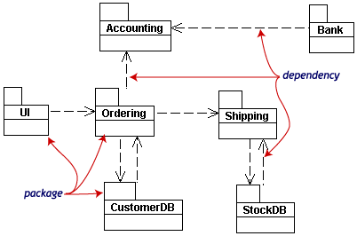
UML Package Diagram
Depicts partitioning of logic into components
Some package stereotypes:
<<façade>>: view; <<framework>>: patterns; <<subsystem>>

Slide 21
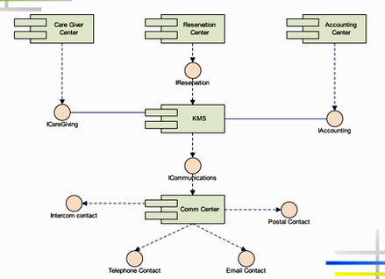
UML Component Diagram
Depicts system as collection of components, with interfaces
Also referred to as "lollipop diagrams"

Slide 22
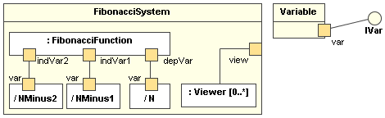
UML Composite Structure Diagram
Shows class's internal structure and collaborations that structure enables.
Can include
▪ internal parts
▪ ports through which parts interact with each other or
class interacts with the parts and outside world
▪ connectors between parts or ports.

Slide 23
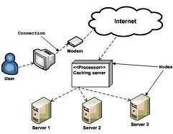
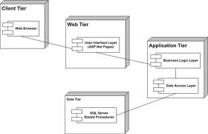
UML Deployment Diagram
Physical mapping of logic/ subsystems to environment
Left-hand style is classic
Right-hand style now fairly common

Slide 24
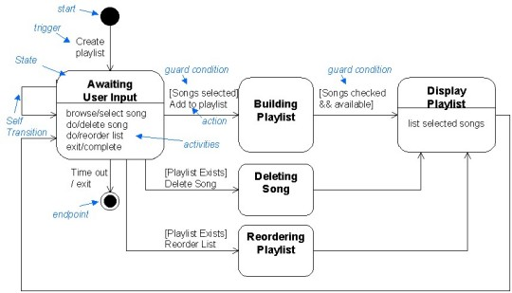
UML Statechart Diagram
Shows operation of a single process

Slide 25
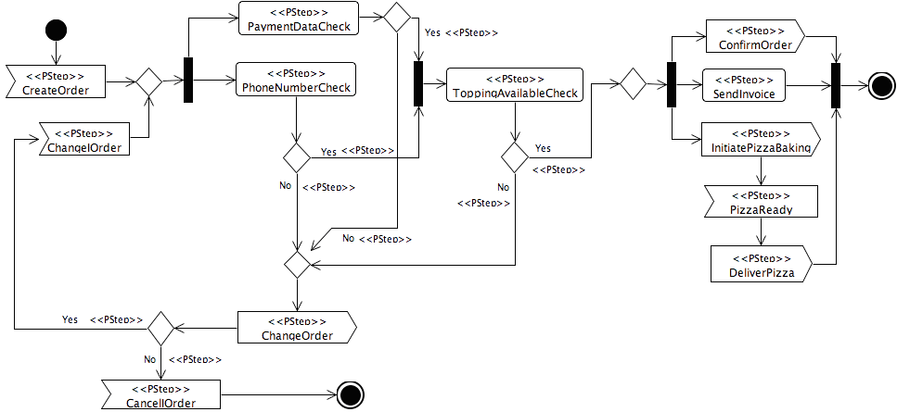
UML: Activity Diagram
Like state diagram, but with multiple loci of activity
Variant for application with parallel processes: swimlanes for partitioning process activity

Slide 26
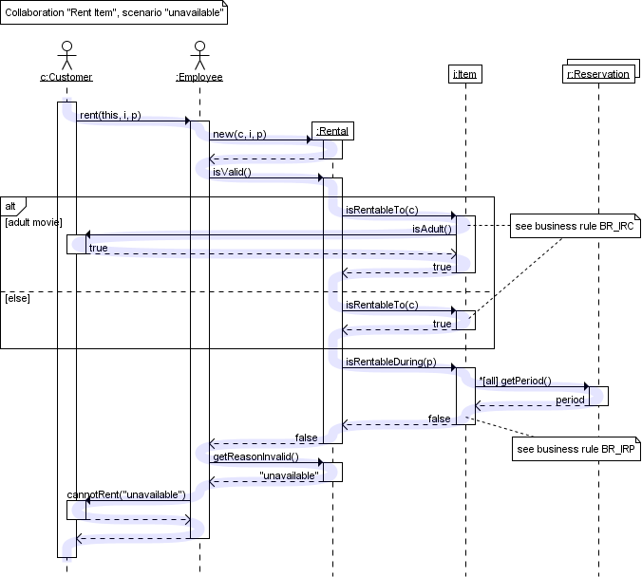
UML Sequence Diagram

Slide 27
UML Sequence Diagrams
At the top is the list of objects, not classes
Show how use cases are implemented
▪ usually start with actor doing some action to system
▪ no internal class/object interactions are shown
Guide to the code implementation
▪ if you can’t understand what the sequence diagram is telling you, you can’t code the program
▪ checking diagram for correctness is critical

Slide 28
Advice for Sequence Diagrams (Ambler)
Strive for left-to-right message ordering
Layer classifiers (i.e., column elements)
Give actors same name as classes, if needed
Include a prose description of the logic
Place proactive actors on the left, reactive actors on the right
Avoid modeling object destruction
Name objects when referenced in messages
Name objects when several of same type exist
Focus on critical interactions
Left-justify message names
Create objects directly
Model return values only when you need them elsewhere in the diagram

Slide 29
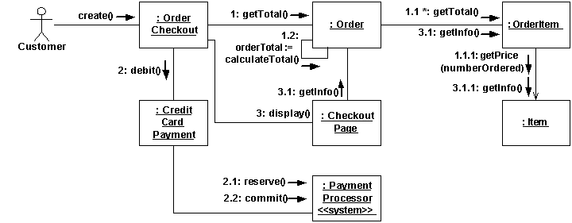
UML: Communication Diagram
Shows static object relationships with dynamic messaging behavior
Formerly called a collaboration diagram
Complemented by sequence diagram

Slide 30
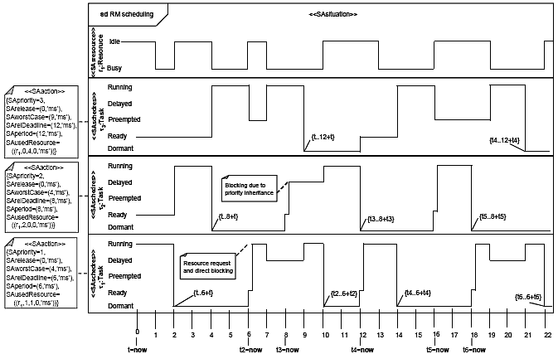
UML Timing Diagram
Like classic electronic engineering timing diagram

